Slide 1
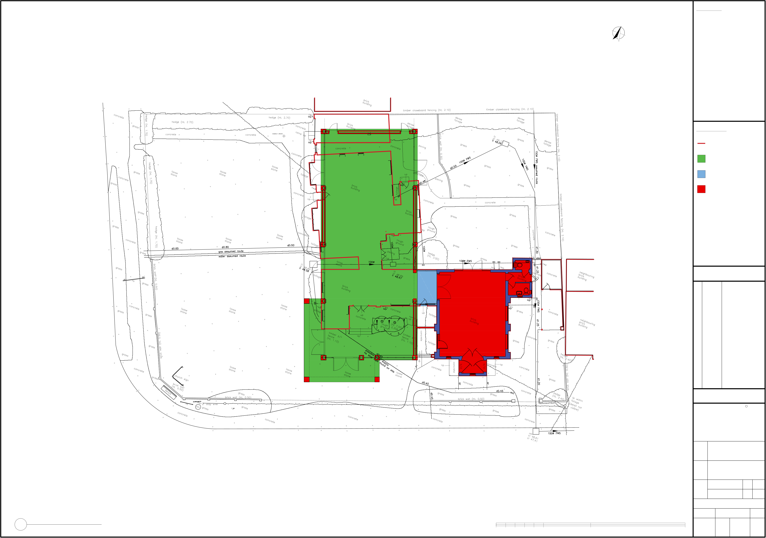
NOTES:
1.
No deviation may be made from the details shown on this prior permission of the architects. found between this drawing and any other document should be referred immediately to the Architects. IF IN ANY DOUBT ASK.
No dimensions should be
scaled from this drawing.
This drawing is to be removed
from currency immediately a
revised version is issued.
All rights described in Chapter
IV of the Copyright, Desings
and Patents Act of 1988 have
been generally asserted.
drawing
without
NORTH
Any
discrepancy
2.
3.
4.
LEGEND:
Existing building outline
New span space
plan
clear
open
Link
Upgrade existing building
REVISIONS
PLANNING
C
JBKS Architects
architects urban designers landscape and product designers
Suite 1, Parkwood Stud, London Road,
Aston Rowant, Oxon, OX49 5SP
Tel: (01844) 350101
Y:\Shared\JBKS Project Files\SHIN - Shinfield Community Church\STAGE 3_DEVELOPED DESIGN\07_DRAWINGS\02_PLANNING DRG's\01_JBKS DRG's\01_DWGs\01_CURRENT\SHIN_06.001.00_Proposed Block Plan.dwg
Job
Shinfield Community Church, Shinfield, Reading
DWG Title
Proposed Block Plan
Scale
1:100 1:200
@ @
A1 A3
Date
April 2024
SCALE BAR 1 : 100 @ A1
Dwg No.
Rev
1
Proposed Block Plan
Scale: 1 : 100
0
5m
10m
20m
SHIN
06
001
00

Slide 2
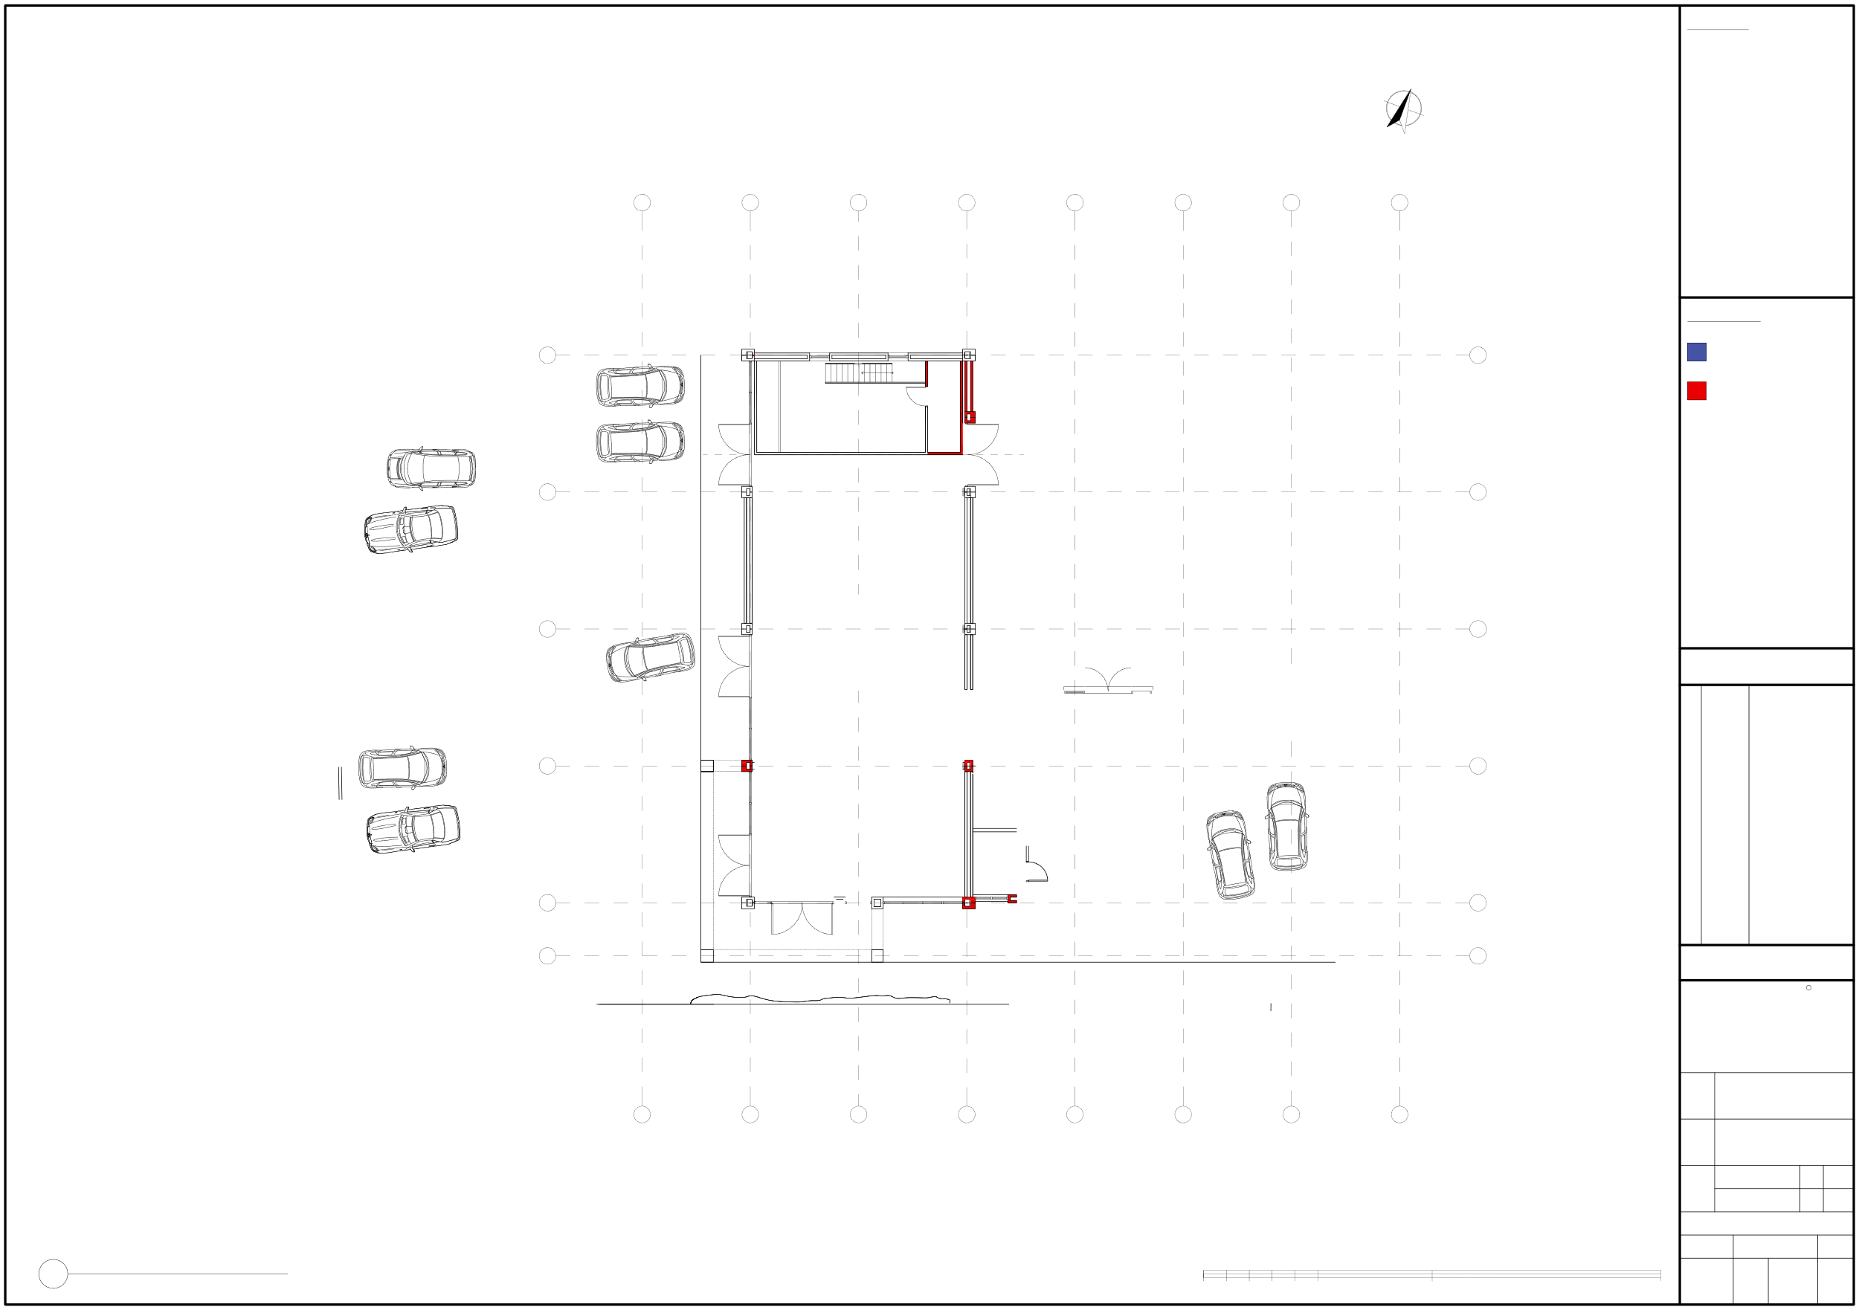
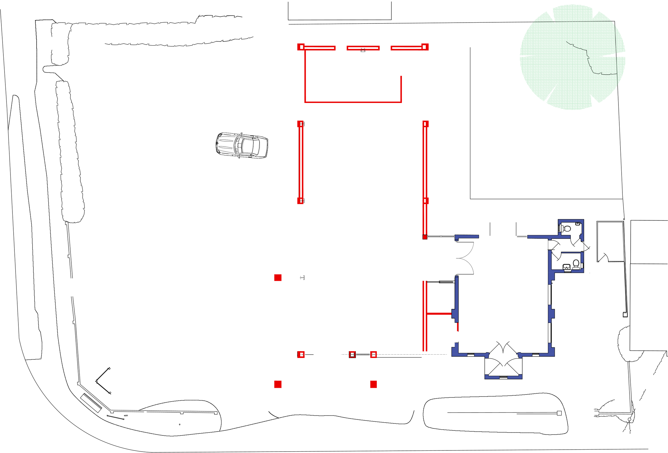
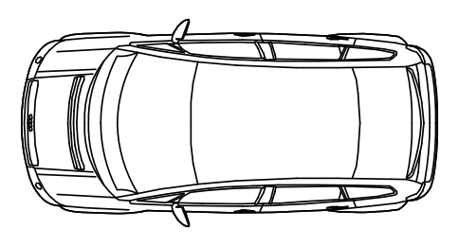

NOTES:
1.
No deviation may be made from the details shown on this prior permission of the architects. found between this drawing and any other document should be referred immediately to the Architects. IF IN ANY DOUBT ASK.
No dimensions should be
scaled from this drawing.
This drawing is to be removed
from currency immediately a
revised version is issued.
All rights described in Chapter
IV of the Copyright, Desings
and Patents Act of 1988 have
been generally asserted.
drawing
without
Any
discrepancy
NORTH
2.
0
1
2
3
4
5
6
7
3.
4.
LEGEND:
E
Smartblocks.co.uk ©
E
Existing building/walls
Smartblocks.co.uk ©
Store
Office
Plant Room
Proposed new building works
Smartblocks.co.uk ©
Smartblocks.co.uk ©
Smartblocks.co.uk ©
D
D
Smartblocks.co.uk ©
Grass
Parking max 19 cars
C
C
Smartblocks.co.uk ©
Paving
REVISIONS
Smartblocks.co.uk ©
B
B
Smartblocks.co.uk ©
©skcolbtramS ku.oc.
brot
mSa
ku©
c.s.o
kcl
A
6m Grid
A
F
Covered area
Paving
F
PLANNING
C
JBKS Architects
architects urban designers landscape and product designers
Suite 1, Parkwood Stud, London Road,
Aston Rowant, Oxon, OX49 5SP
4.7m Grid
Tel: (01844) 350101
Y:\Shared\JBKS Project Files\SHIN - Shinfield Community Church\STAGE 3_DEVELOPED DESIGN\07_DRAWINGS\02_PLANNING DRG's\01_JBKS DRG's\01_DWGs\01_CURRENT\SHIN_06.112.00_Proposed First Floor Plan.dwg
Job
Shinfield Community Church, Shinfield, Reading
0
1
2
3
4
5
6
7
DWG Title
Proposed First Floor Plan
Scale
1:100 1:200
@ @
A1 A3
Date
April 2024
SCALE BAR 1 : 100 @ A1
Dwg No.
Rev
1
Proposed First Floor Plan
Scale: 1 : 100
0
5m
10m
20m
SHIN
06
112
00

Slide 3
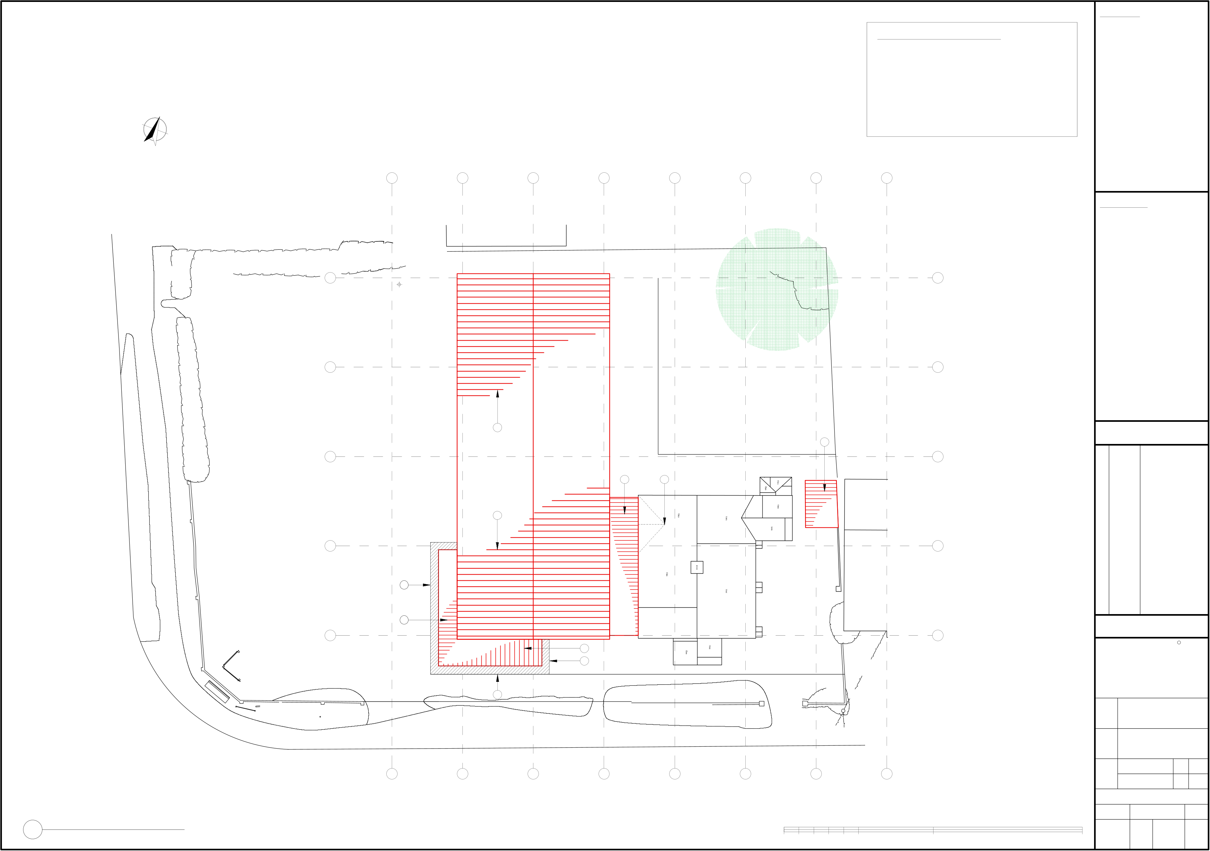
NOTES:
ROOF SPECIFIC NOTES:
1.New pitched roof; 2.New flat roof; 3.Parapet wall;
1.
No deviation may be made from the details shown on this prior permission of the architects. found between this drawing and any other document should be referred immediately to the Architects. IF IN ANY DOUBT ASK.
No dimensions should be
scaled from this drawing.
This drawing is to be removed
from currency immediately a
revised version is issued.
All rights described in Chapter
IV of the Copyright, Desings
and Patents Act of 1988 have
been generally asserted.
drawing
without
Any
discrepancy
4.
Existing roof to be reverted to pitched roof to
2.
tie-in with new flat roof;
3.
NORTH
4.
0
1
2
3
4
5
6
7
LEGEND:
E
E
D
D
1
2
REVISIONS
C
C
2
4
1
B
B
3
A
2
A
PLANNING
2
C
3
JBKS Architects
architects urban designers landscape and product designers
Suite 1, Parkwood Stud, London Road,
Aston Rowant, Oxon, OX49 5SP
Tel: (01844) 350101
3
Y:\Shared\JBKS Project Files\SHIN - Shinfield Community Church\STAGE 3_DEVELOPED DESIGN\07_DRAWINGS\02_PLANNING DRG's\01_JBKS DRG's\01_DWGs\01_CURRENT\SHIN_06.113.00_Proposed Roof Plan.dwg
Job
Shinfield Community Church, Shinfield, Reading
DWG Title
Proposed New Roof Plan
0
1
2
3
4
5
6
7
Scale
1:100 1:200
@ @
A1 A3
Date
April 2024
SCALE BAR 1 : 100 @ A1
Dwg No.
Rev
1
Proposed New Roof Plan
Scale: 1 : 100
0
5m
10m
20m
SHIN
06
113
00

Slide 4
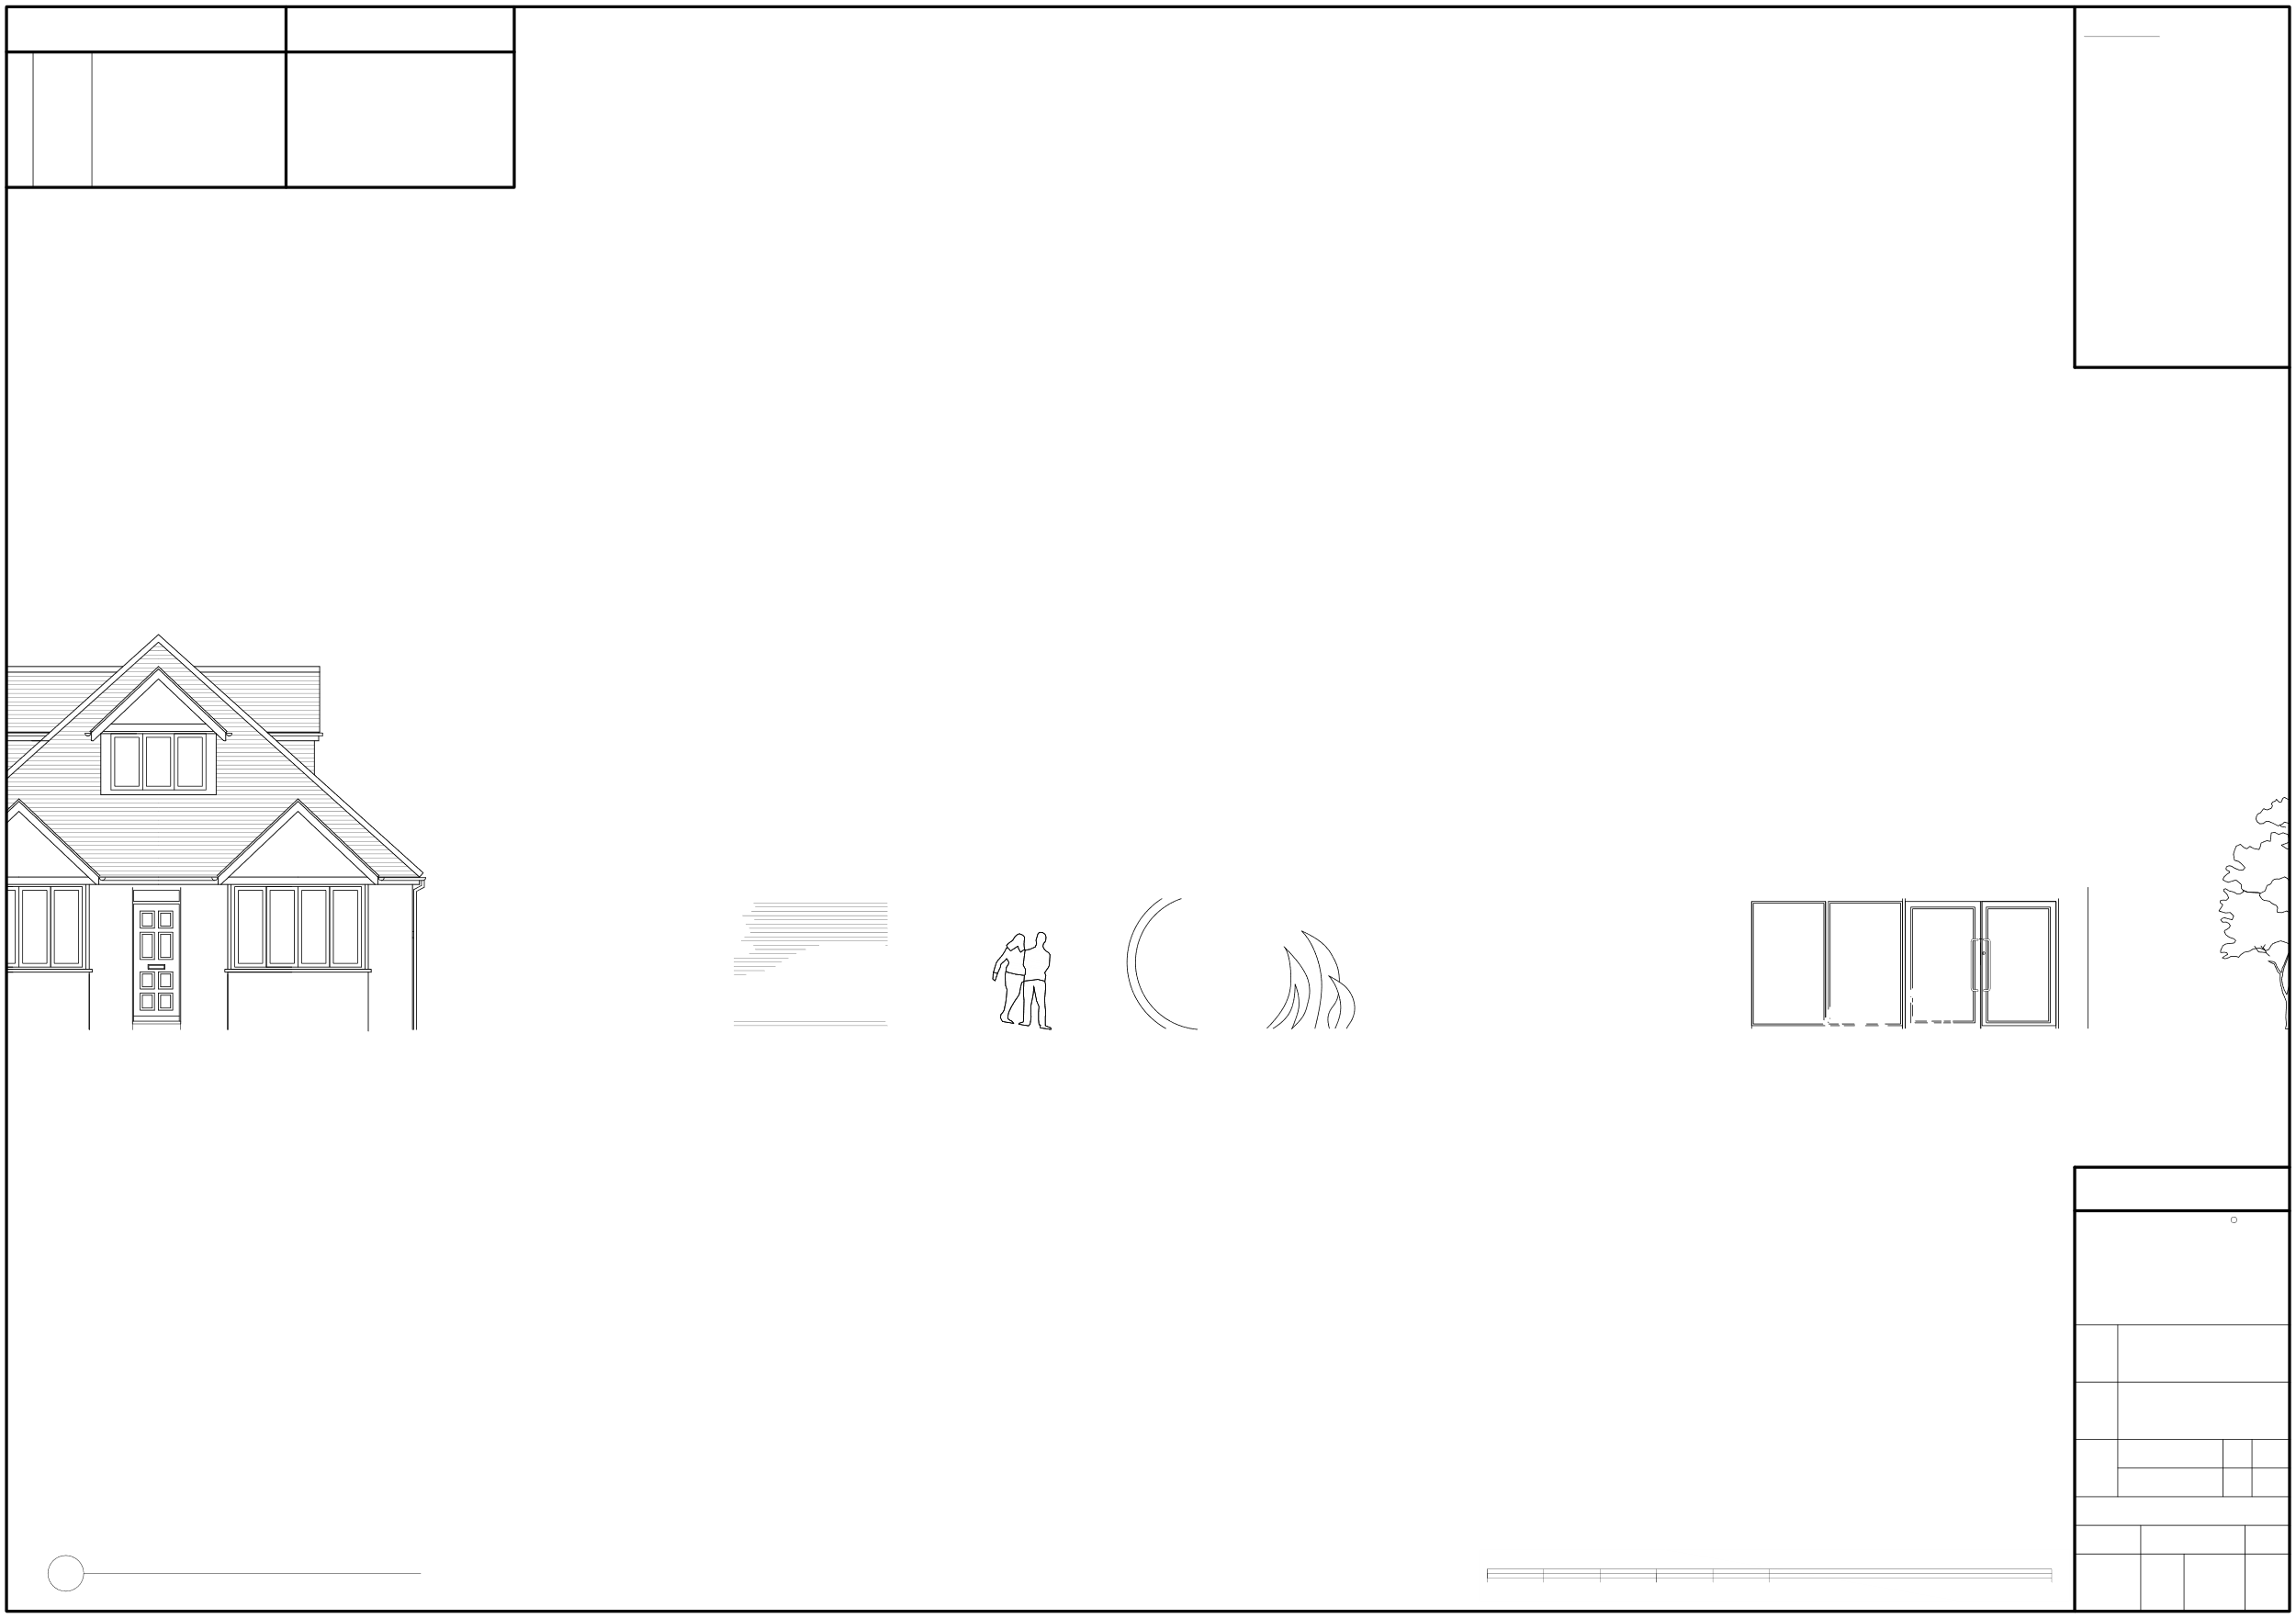
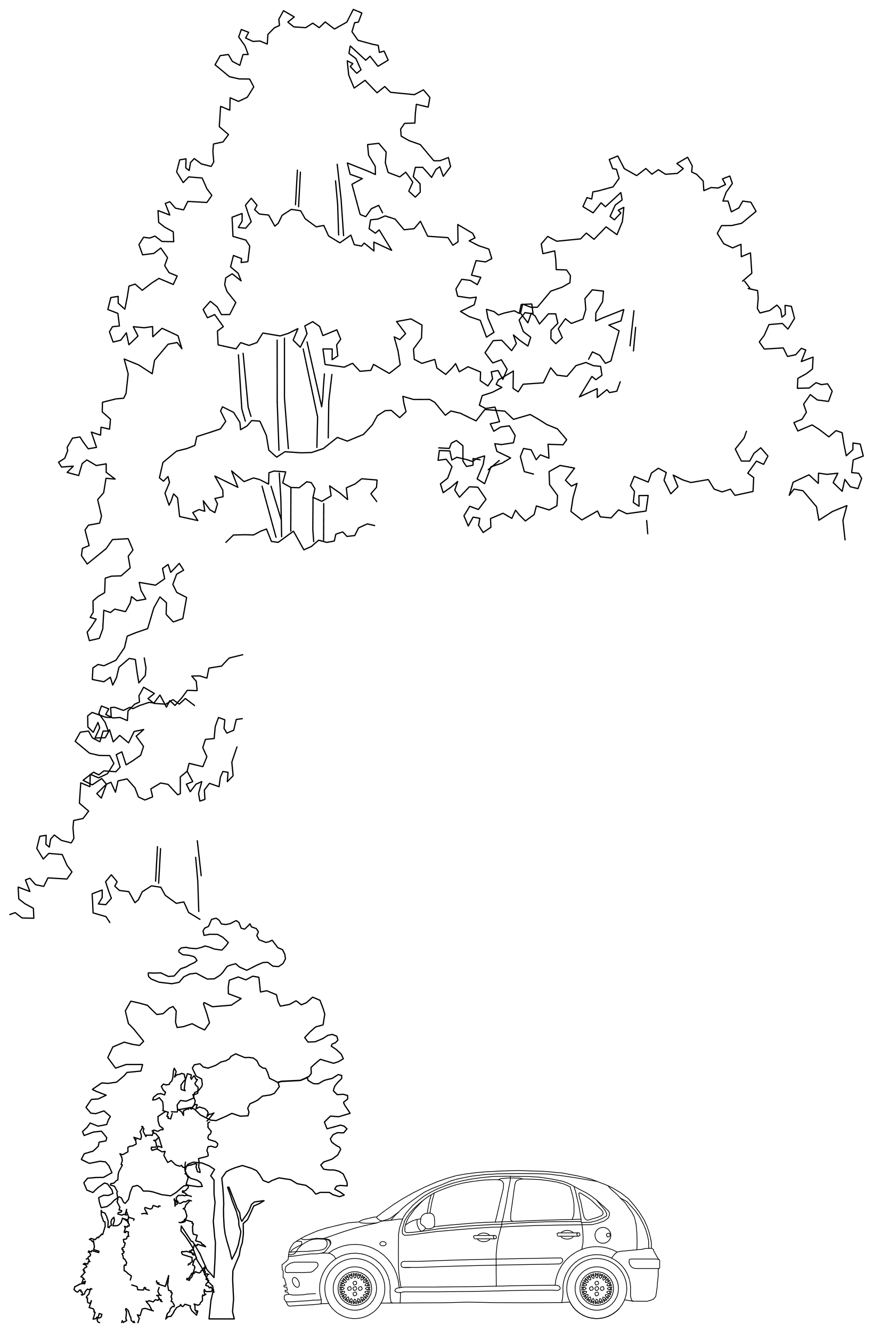

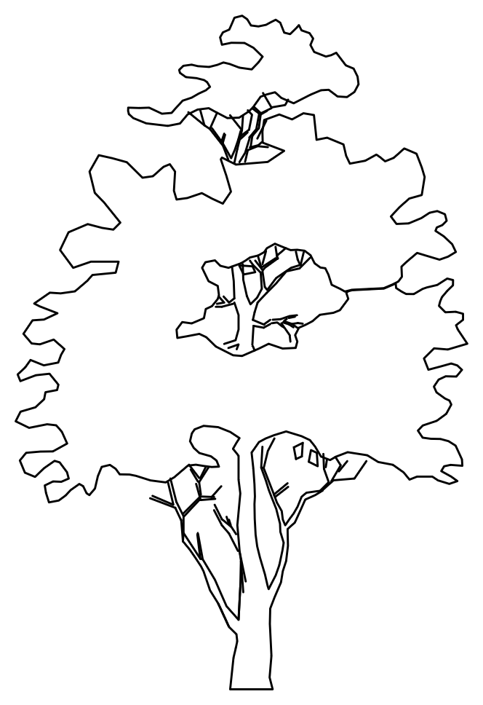
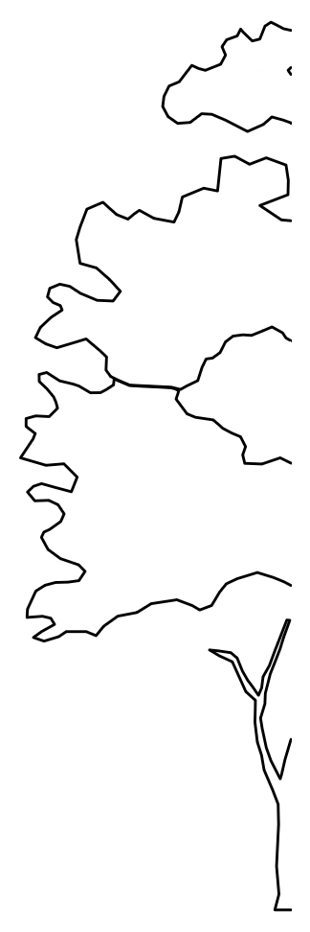






REVISIONS
LEGEND
NOTES:
1.
No deviation may be made from the details shown on this prior permission of the architects. found between this drawing and any other document should be referred immediately to the Architects. IF IN ANY DOUBT ASK.
No dimensions should be
scaled from this drawing.
This drawing is to be removed
from currency immediately a
revised version is issued.
All rights described in Chapter
IV of the Copyright, Desings
and Patents Act of 1988 have
been generally asserted.
drawing
without
Any
discrepancy
2.
3.
4.
Shinfield Community Church
Smartblocks.co.uk ©
PLANNING
C
JBKS Architects
architects urban designers landscape and product designers
Suite 1, Parkwood Stud, London Road,
Aston Rowant, Oxon, OX49 5SP
Y:\Shared\JBKS Project Files\SHIN - Shinfield Community Church\STAGE 3_DEVELOPED DESIGN\07_DRAWINGS\02_PLANNING DRG's\01_JBKS DRG's\01_DWGs\01_CURRENT\SHIN_06.120.00_Proposed South West Elevation.dwg
Tel: (01844) 350101
Job
Shinfield Community Church, Shinfield, Reading
DWG Title
Proposed South West Elevation
Scale
1:50 1:100
@ @
A1 A3
Date
April 2024
SCALE BAR 1 : 50 @ A1
Dwg No.
Rev
1
Proposed South West Elevation
Scale: 1 : 50
0
1m
5m
10m
SHIN
06
120
00

Slide 5
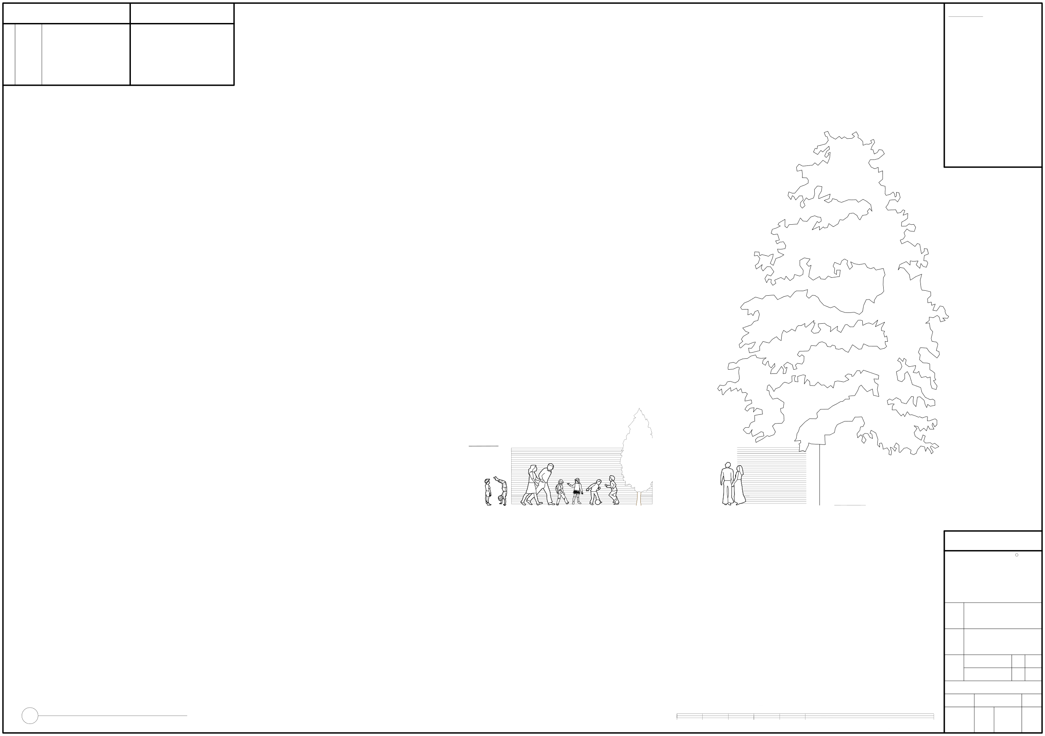

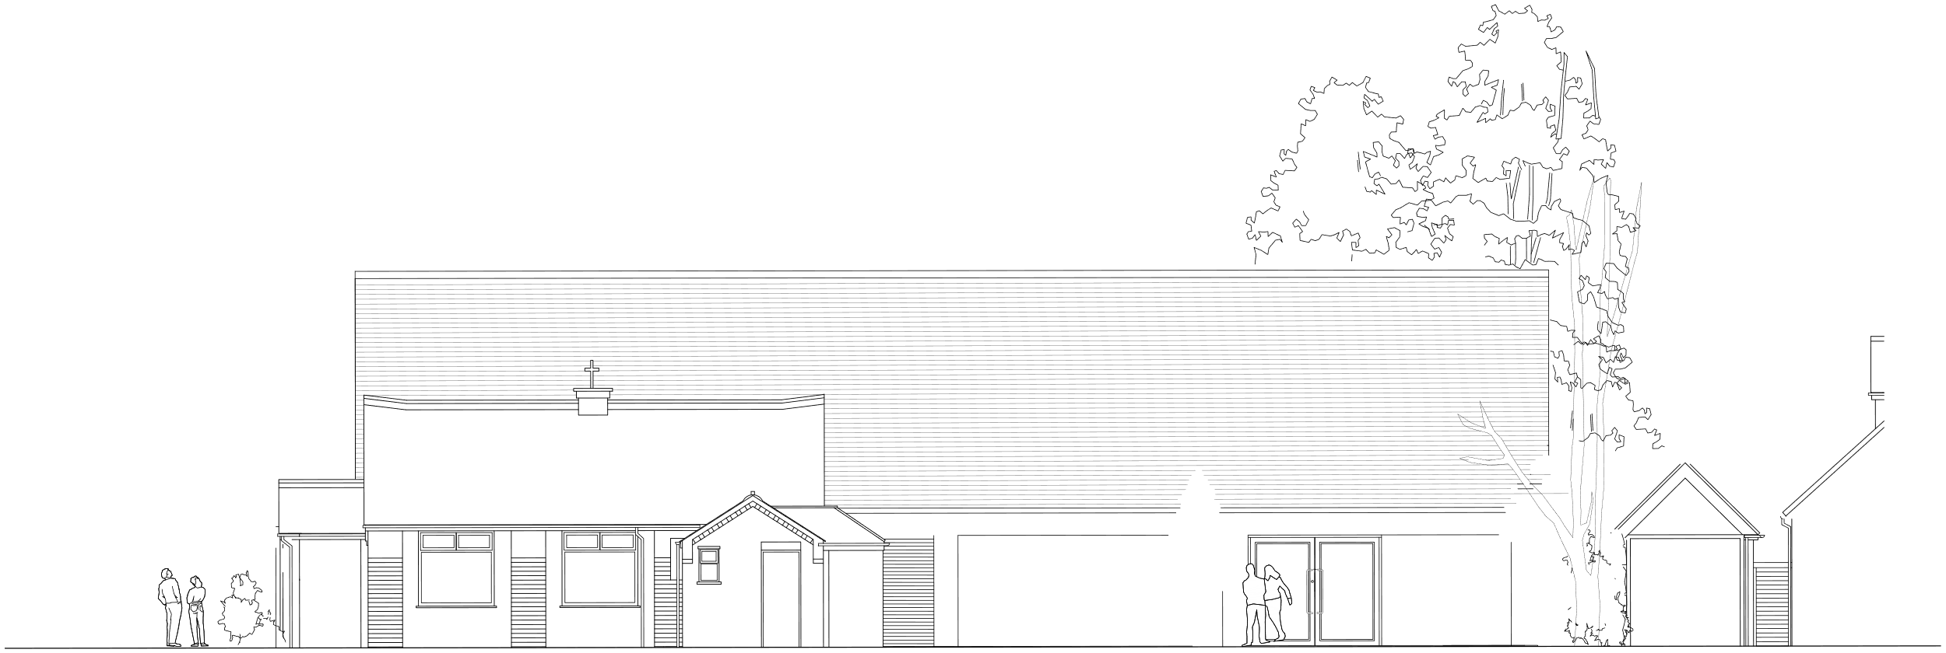
REVISIONS
LEGEND
NOTES:
1.
No deviation may be made from the details shown on this prior permission of the architects. found between this drawing and any other document should be referred immediately to the Architects. IF IN ANY DOUBT ASK.
No dimensions should be
scaled from this drawing.
This drawing is to be removed
from currency immediately a
revised version is issued.
All rights described in Chapter
IV of the Copyright, Desings
and Patents Act of 1988 have
been generally asserted.
drawing
without
Any
discrepancy
2.
3.
4.
PLANNING
C
JBKS Architects
architects urban designers landscape and product designers
Suite 1, Parkwood Stud, London Road,
Aston Rowant, Oxon, OX49 5SP
Y:\Shared\JBKS Project Files\SHIN - Shinfield Community Church\STAGE 3_DEVELOPED DESIGN\07_DRAWINGS\02_PLANNING DRG's\01_JBKS DRG's\01_DWGs\01_CURRENT\SHIN_06.121.00_Proposed North East Elevation.dwg
Tel: (01844) 350101
Job
Shinfield Community Church, Shinfield, Reading
DWG Title
Proposed North East Elevation
Scale
1:50 1:100
@ @
A1 A3
Date
April 2024
SCALE BAR 1 : 50 @ A1
Dwg No.
Rev
1
Proposed North East Elevation
Scale: 1 : 50
0
1m
5m
10m
SHIN
06
121
00

Slide 6
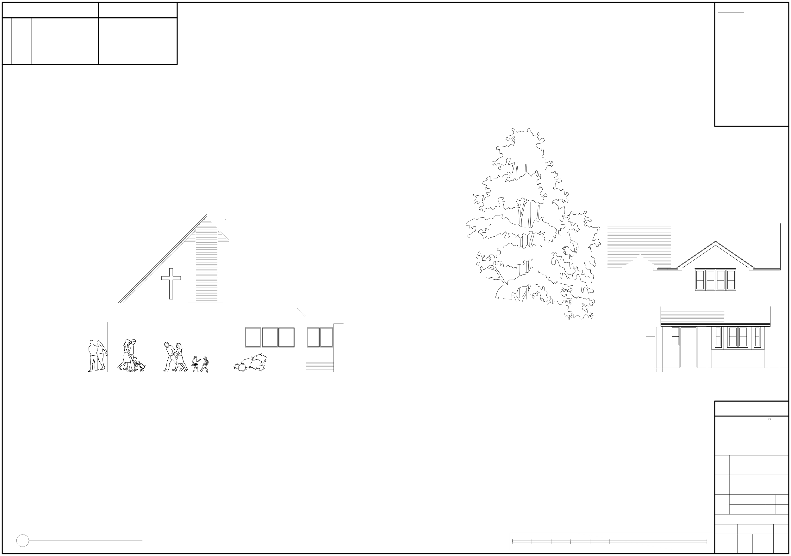
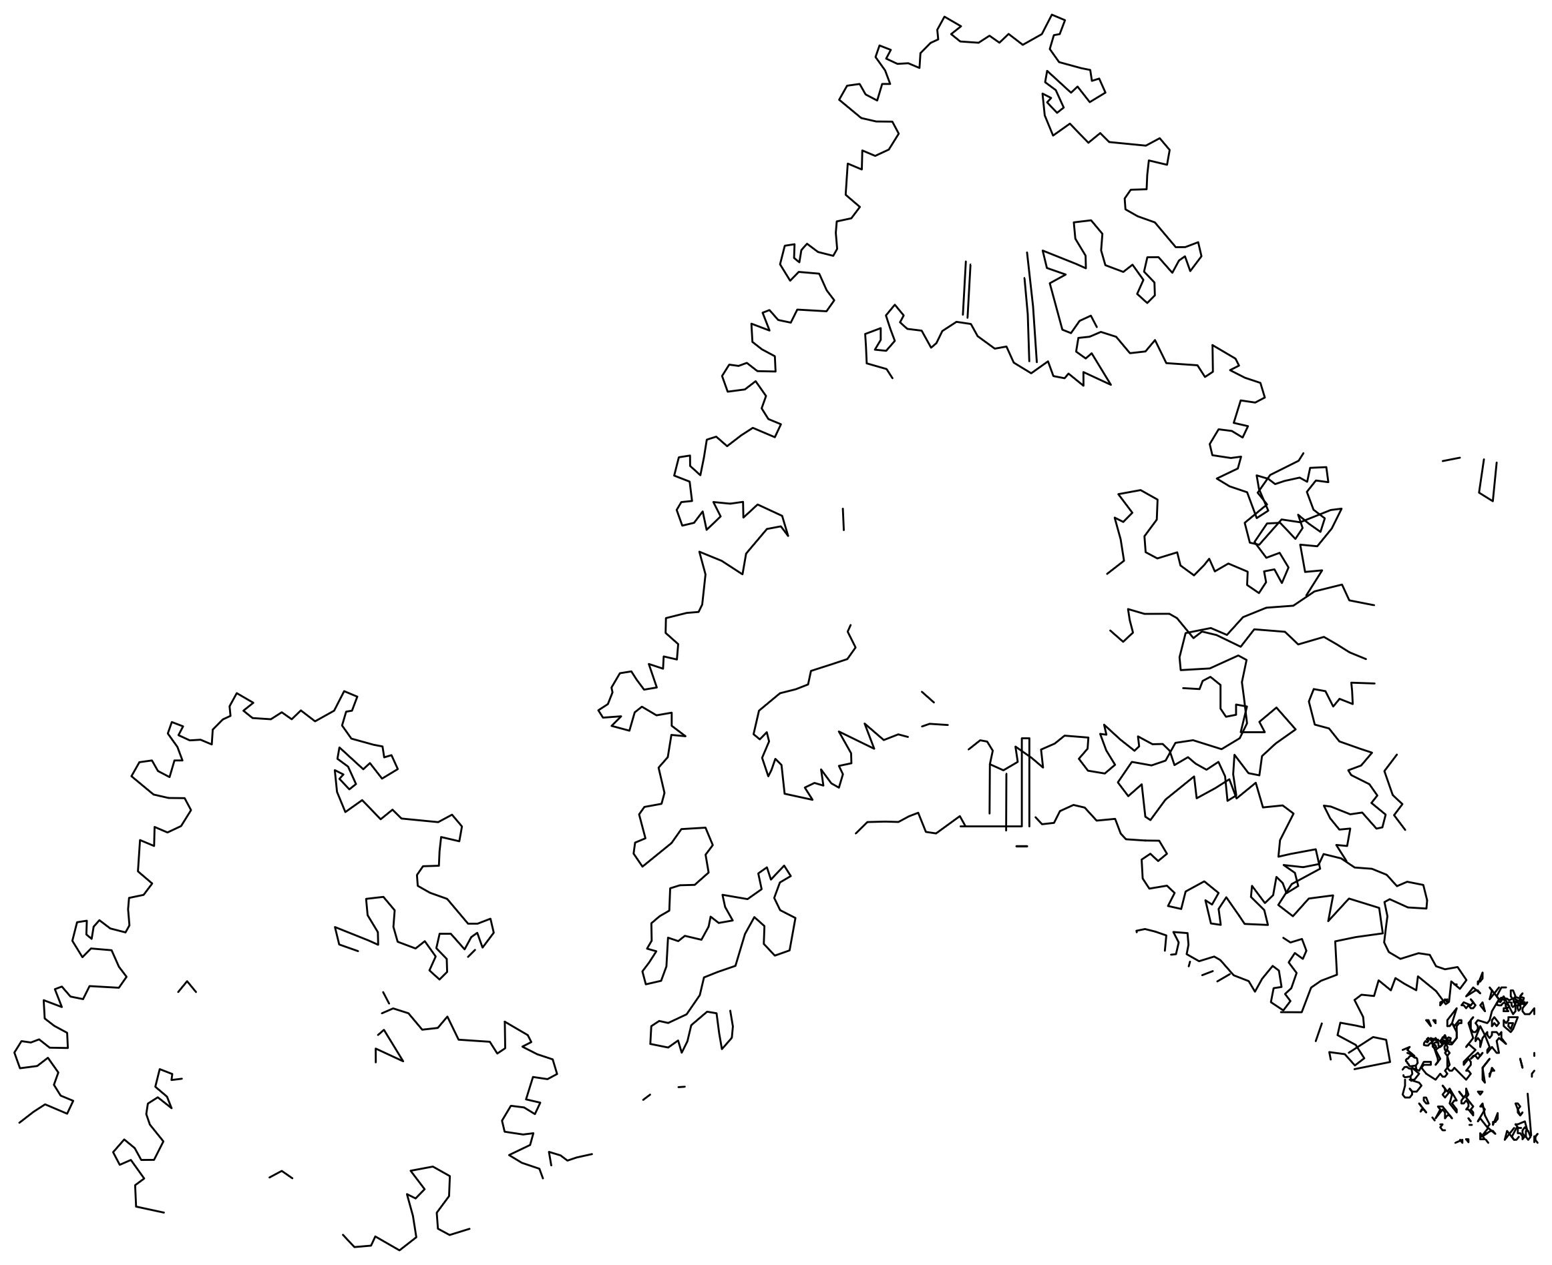
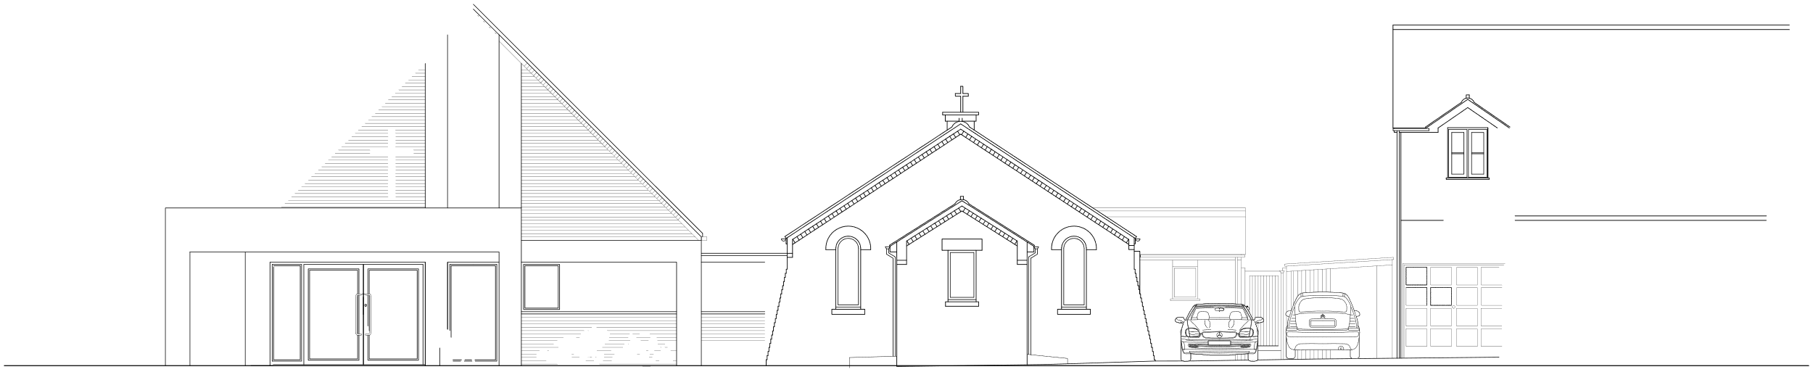
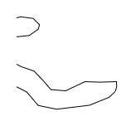

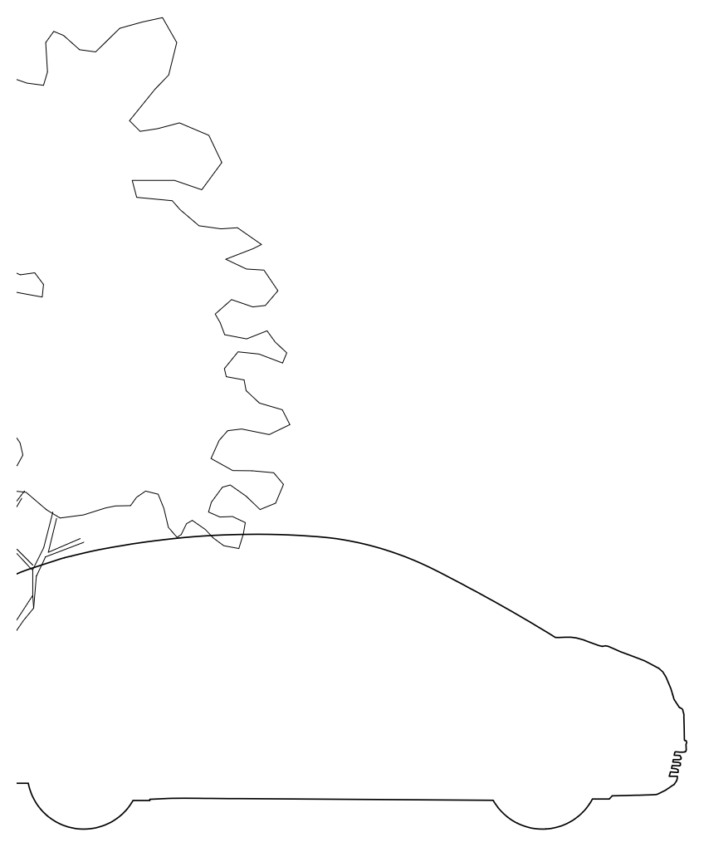
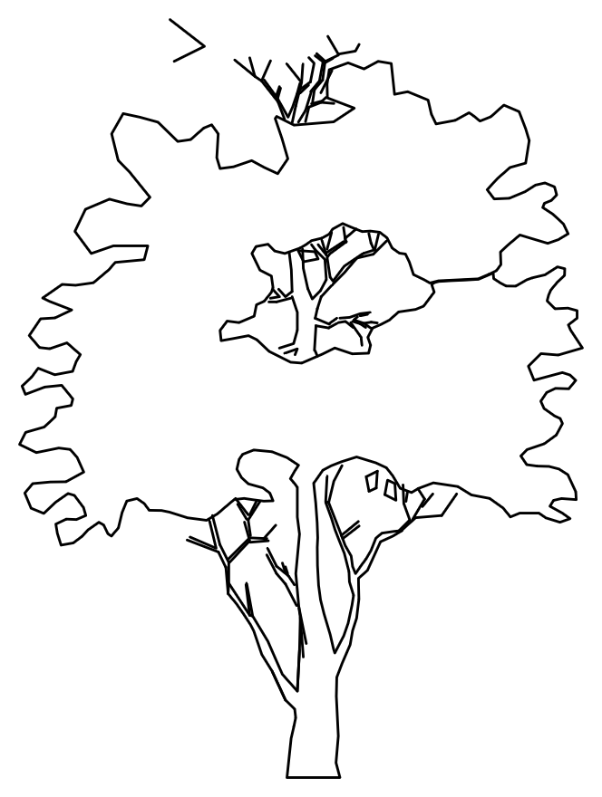


REVISIONS
LEGEND
NOTES:
1.
No deviation may be made from the details shown on this prior permission of the architects. found between this drawing and any other document should be referred immediately to the Architects. IF IN ANY DOUBT ASK.
No dimensions should be
scaled from this drawing.
This drawing is to be removed
from currency immediately a
revised version is issued.
All rights described in Chapter
IV of the Copyright, Desings
and Patents Act of 1988 have
been generally asserted.
drawing
without
Any
discrepancy
2.
3.
4.
Shinfield Community Church
Smartblocks.co.uk ©
Smartblocks.co.uk ©
PLANNING
C
JBKS Architects
architects urban designers landscape and product designers
Suite 1, Parkwood Stud, London Road,
Aston Rowant, Oxon, OX49 5SP
Y:\Shared\JBKS Project Files\SHIN - Shinfield Community Church\STAGE 3_DEVELOPED DESIGN\07_DRAWINGS\02_PLANNING DRG's\01_JBKS DRG's\01_DWGs\01_CURRENT\SHIN_06.122.00_Proposed South East Elevation.dwg
Tel: (01844) 350101
Job
Shinfield Community Church, Shinfield, Reading
DWG Title
Proposed South East Elevation
Scale
1:50 1:100
@ @
A1 A3
Date
April 2024
SCALE BAR 1 : 50 @ A1
Dwg No.
Rev
1
Proposed South East Elevation
Scale: 1 : 50
0
1m
5m
10m
SHIN
06
122
00

Slide 7

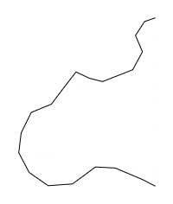
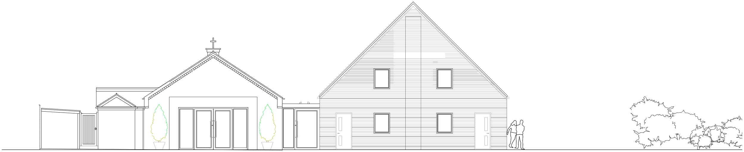







REVISIONS
LEGEND
NOTES:
1.
No deviation may be made from the details shown on this prior permission of the architects. found between this drawing and any other document should be referred immediately to the Architects. IF IN ANY DOUBT ASK.
No dimensions should be
scaled from this drawing.
This drawing is to be removed
from currency immediately a
revised version is issued.
All rights described in Chapter
IV of the Copyright, Desings
and Patents Act of 1988 have
been generally asserted.
drawing
without
Any
discrepancy
2.
3.
4.
PLANNING
C
JBKS Architects
architects urban designers landscape and product designers
Suite 1, Parkwood Stud, London Road,
Aston Rowant, Oxon, OX49 5SP
Y:\Shared\JBKS Project Files\SHIN - Shinfield Community Church\STAGE 3_DEVELOPED DESIGN\07_DRAWINGS\02_PLANNING DRG's\01_JBKS DRG's\01_DWGs\01_CURRENT\SHIN_06.123.00_Proposed North West Elevation.dwg
Tel: (01844) 350101
Job
Shinfield Community Church, Shinfield, Reading
DWG Title
Proposed North West Elevation
Scale
1:50 1:100
@ @
A1 A3
Date
April 2024
SCALE BAR 1 : 50 @ A1
Dwg No.
Rev
1
Proposed North West Elevation
Scale: 1 : 50
0
1m
5m
10m
SHIN
06
123
00

Slide 8
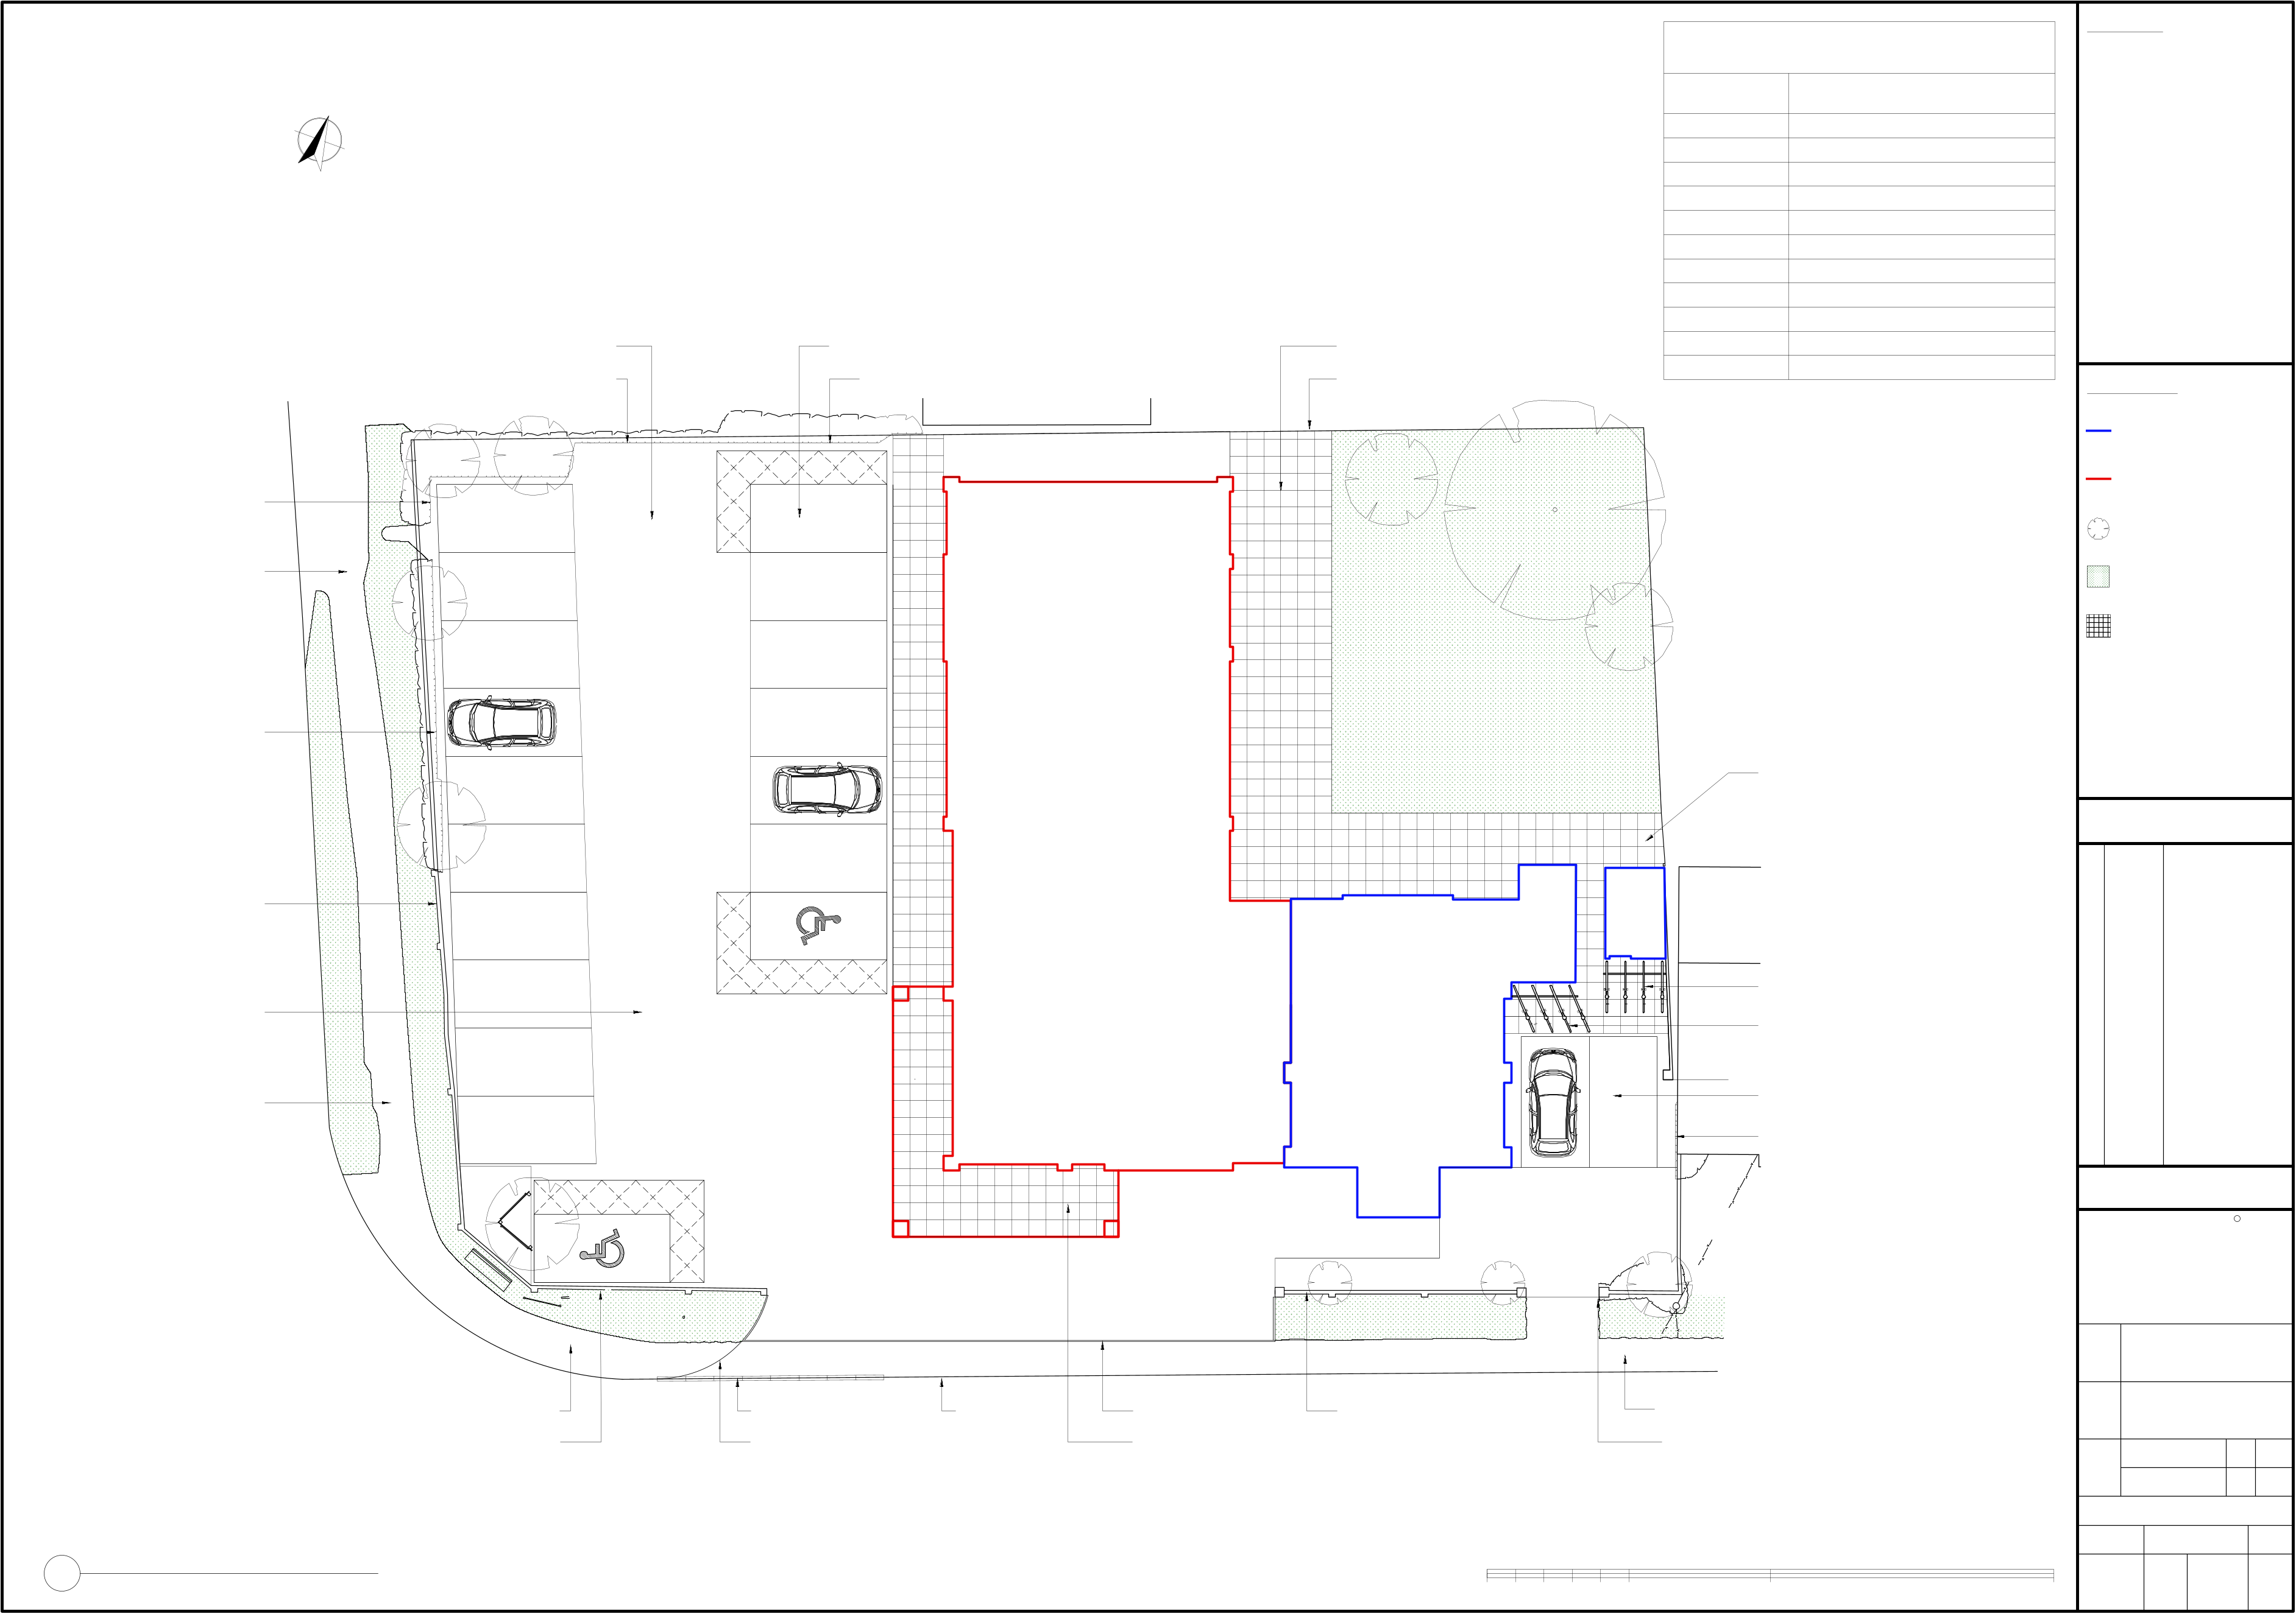
TREE SCHEDULE
NOTES:
1.
No deviation may be made from the details shown on this prior permission of the architects. found between this drawing and any other document should be referred immediately to the Architects. IF IN ANY DOUBT ASK.
No dimensions should be
scaled from this drawing.
This drawing is to be removed
from currency immediately a
revised version is issued.
All rights described in Chapter
IV of the Copyright, Desings
and Patents Act of 1988 have
been generally asserted.
NUMBER
DESCRITION
drawing
without
T1 T2 T3 T4 T5 T6 T7 T8 T9 T10 T11
T.B.C T.B.C T.B.C T.B.C T.B.C T.B.C T.B.C T.B.C T.B.C T.B.C T.B.C
Any
discrepancy
NORTH
2.
3.
4.
New asphalt surfacing
Parent + Child parking bay
New 600mm x 600mm concrete paving
Trim back hedge
Trim back hedge
Trim back hedge
LEGEND:
T10
T11
Gravel
Existing building/walls
Trim back hedge
T3
T1
Proposed new building works
1
12
Trees
Existing asphalt sidewalk
T9
2
13
Grass
Asphalt
T2
Concrete paving
3
14
Grass
Smartblocks.co.uk ©
Trim back hedge
Smartblocks.co.uk ©
4
15
5
16
New 600mm x 600mm concrete paving
Car Park
Smartblocks.co.uk ©
REVISIONS
T8
Smartblocks.co.uk ©
6
17
Existing wall
7
18
New asphalt surfacing
8
New cycle racks
New cycle racks
9
Asphalt
New asphalt surfacing
Existing asphalt sidewalk
10
Smartblocks.co.uk ©Smartblocks.co.uk ©
Trim back hedge
Gravel
PLANNING
T7
C
11
JBKS Architects
architects urban designers landscape and product designers
Suite 1, Parkwood Stud, London Road,
Aston Rowant, Oxon, OX49 5SP
Asphalt
T6
T5
T4
Y:\Shared\JBKS Project Files\SHIN - Shinfield Community Church\STAGE 3_DEVELOPED DESIGN\07_DRAWINGS\02_PLANNING DRG's\01_JBKS DRG's\01_DWGs\01_CURRENT\SHIN_06.901.00_Proposed Landscaping Plan.dwg
Grass
Grass
Tel: (01844) 350101
Job
Shinfield Community Church, Shinfield, Reading
Existing asphalt sidewalk
Extend kerb drop by 8m
Existing kerb
New edging
Existing wall. Reinstated where required
Existing asphalt sidewalk
DWG Title
Proposed Landscaping Plan
Existing wall. Reinstated where required
New bellmouth with R = 4m
New 600mm x 600mm concrete paving
Trim back hedge
1:100 1:200
@ @
A1 A3
Scale
Date
April 2024
SCALE BAR 1 : 100 @ A1
Dwg No.
Rev
1
Proposed Landscaping Plan
Scale: 1 : 100
0
5m
10m
20m
SHIN
06
901
00

